Slide 1
PRIORITY RISK IDENTIFICATION AND SCOPE MEASUREMENT
Presenters: Yuthika Shekhar, Abhijeet Talaulikar, Sajid Hussain Rafi Ahamed, Hailey Thanki, Siddharth Susarla
Mentor: Cantay Caliskan
Wednesday November 9, 2022

Slide 2

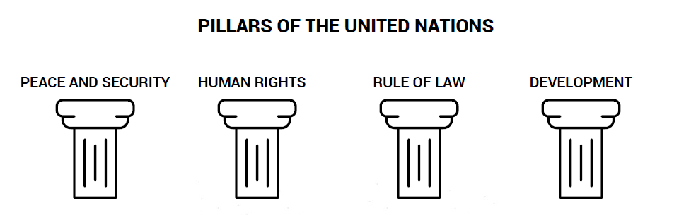
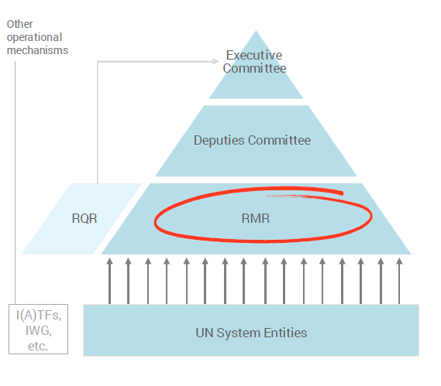
United Nations
The United Nations is an international organization-193 Member States.
Regional Monthly Review (chaired by Secretary General) body conducts bi-annual surveys.
Notes:
Regional Monthly Reviews (RMR), conceived under the Human Rights Up Front policy, were developed to ensure that the UN system has a shared understanding of situations and takes early and coordinated action for prevention

Slide 3
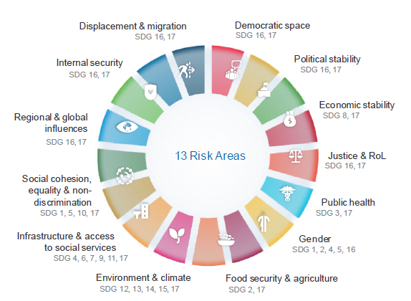
Project Vision and Goals
Vision:
To improve UN's capacity to meet Sustainable Development Goals by the year 2030.
Goals:
Identify which survey variable is the best predictor of priority risks.
Identify which survey variable is the best predictor of UN action urgency and its extent.

Slide 4
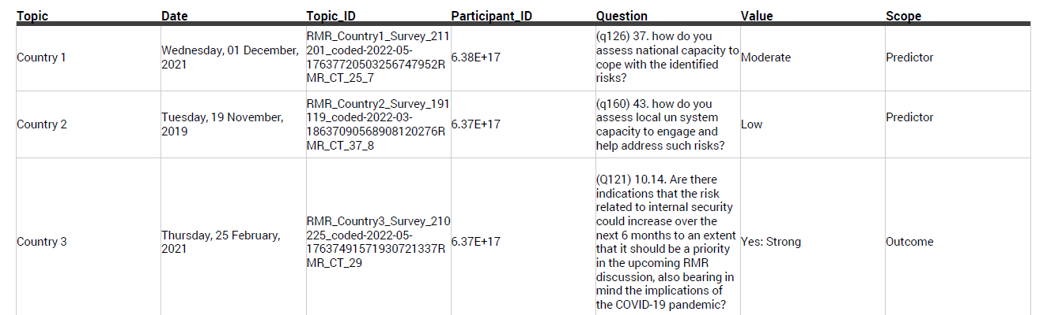
Overview of the Data
63 surveys, 3 years (2019 to 2021), 53 countries, 62 UN entities, 667 participants.
Size: 16K rows, 7 columns

Slide 5
Additional Data Obtained
1. Country mapping
Names of the countries available
53 countries
2. New survey data
Contained 4699 rows
Information about new countries
Surveys conducted in 2022

Slide 6
Survey Questions
6 question types.
Example questions
Change in UN engagement by extent and urgency: From your perspective, would the scenario you identify require a change in UN engagement over the next 6 months?
Priority risks: (Multi-select) Please select the risk areas you would like to identify as a priority for the RMR discussion.
Identity and demographics: Please select your entity from the drop-down list. If you are submitting for the Resident Coordinator or equivalent, please ensure to select 'UN Resident Coordinator’.
National coping capacity: How do you assess national capacity to cope with the identified risks?
Risk increase potential: Are there indications that the risk related to environment & climate could increase over the next 6 months to an extent that it should be a priority in the upcoming RMR discussion, also bearing in mind the implications of the COVID-19 pandemic?
UN response capacity: How do you assess local un system capacity to engage and help address such risks?

Slide 7
Interpretation of Missing Data
Non-response bias: Survey participants may answer a question with “Don’t know” or skipped the question.
Question was not asked: Surveys have been evolving – older surveys do not have some of the questions from newer surveys.

Slide 8
Analysis Variables
Predictor variables:
Answers to various survey questions by participants
Outcome Variable:
Outcome column - Combinations of different risk factors or UN action urgency

Slide 9
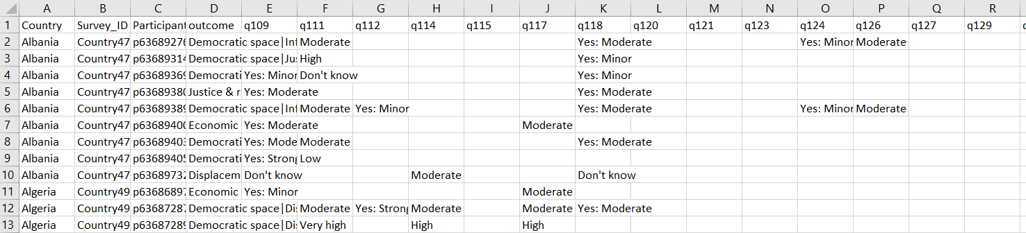
Transformed Survey Data
Treat every survey + participant combination as a row.
Each row can be interpreted as an opinion of a participant in a specific survey about a country.
Columns = maximum number of questions per survey
New size: 860 rows. rows, 48 columns
Participant responses
Question responses

Slide 10
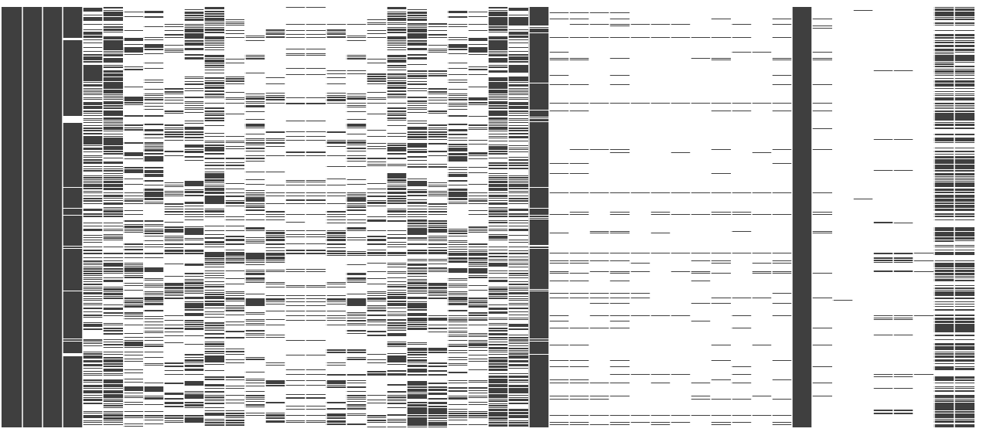
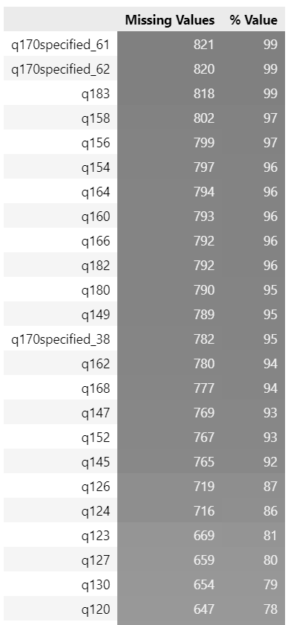
Visualizing Data Sparsity
Participant responses
Question responses
Filled
Missing
Percentage of missing data

Slide 11
Mapping of Response
10 qualitative responses presented to participants across surveys
Standardized the weight of the responses using a Net Promoter Score
Response | Score
Yes: Very Strong, Very High | 5
Yes: Strong, High | 4
Yes: Moderate, Moderate | 3
Yes: Minor, Low | 2
No | 1
Don't Know | -1
None | 0
Notes:
The resulting aggregate scores closely aligned with UNs internal ranking for the risk predictors, hence validating our approach.

Slide 12
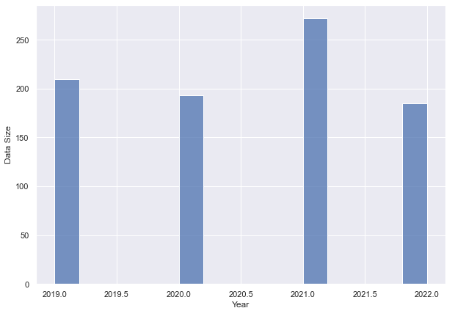
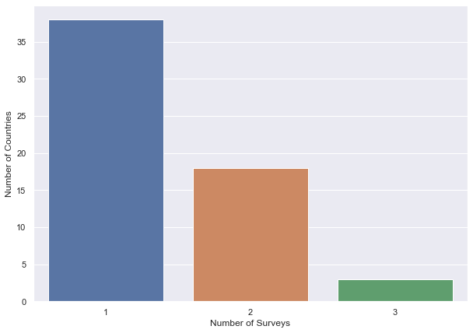
Descriptive Analysis
Data Size
Number of Countries
Year
Number of Surveys
Distribution of data from 2019 to 2022
85% of countries had a single survey.

Slide 13
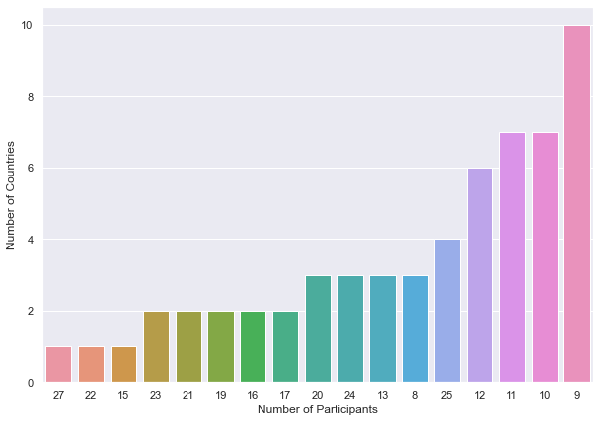
Descriptive Analysis
Number of Countries
About 24 countries had just 9 to 10 participants take the survey.
Number of Participants

Slide 14
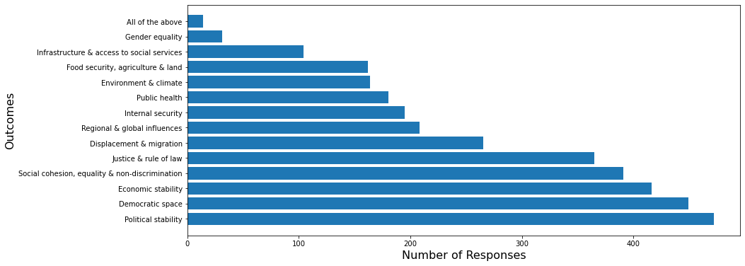
Distribution of Risk Factors
Most common Political Stability, Democratic Space, Economic Stability
Least common
Infrastructure, Gender Equality, Food security
‹#›

Slide 15
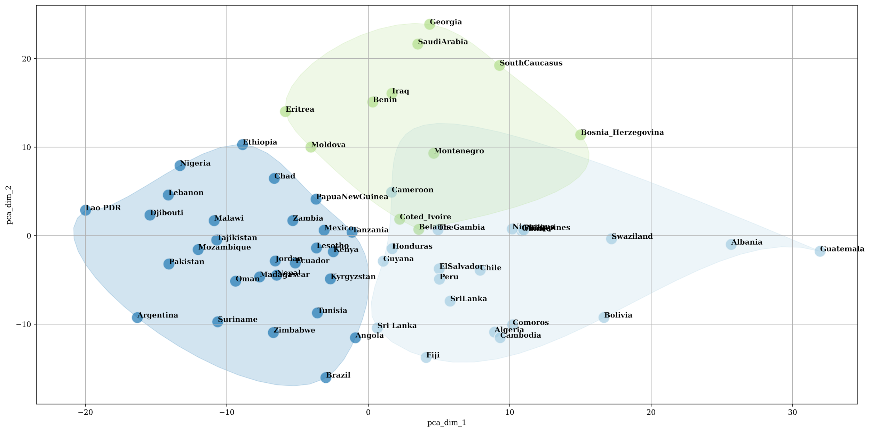
Priority Risk Clusters
Grouping countries based on participant perceptions of the 13 risks.
Goal: Enabling UN to standardize their actions based on similar risks.
Features: 13 features for prevalence of risk factors
Algorithm: K-Means
Cluster C1:
Significantly low perception of food insecurity as a risk.
Possibly, well developed infrastructure and healthcare.
Cluster C2:
Economic stability, political stability and public health are a concern.
Food security is perceived as a risk.
Cluster C3:
Major risks in social cohesion, democratic space, economic stability, displacement, justice.
C2
C3
C1
‹#›

Slide 16
Priority & Impending Risk
Algorithm: FP-Growth
31% Priority risk - Food Security
27% Priority risk - Democratic Space
27% Priority risk - Social Cohesion
25% Priority risk - Social Cohesion
23% Priority risk - Social Cohesion
23% Priority risk – Democratic Space
When economic stability, political stability, democratic space or justice are an identified risk, 30% of the participants thought the UN engagement needed a significant change over coming months.
Impending risk - Economic Stability
Impending risk - Political Stability
Impending risk - Political Stability
Impending risk - Democratic Space
Impending risk - Justice & Rule of Law
Impending risk - Justice & Rule of Law
‹#›

Slide 17
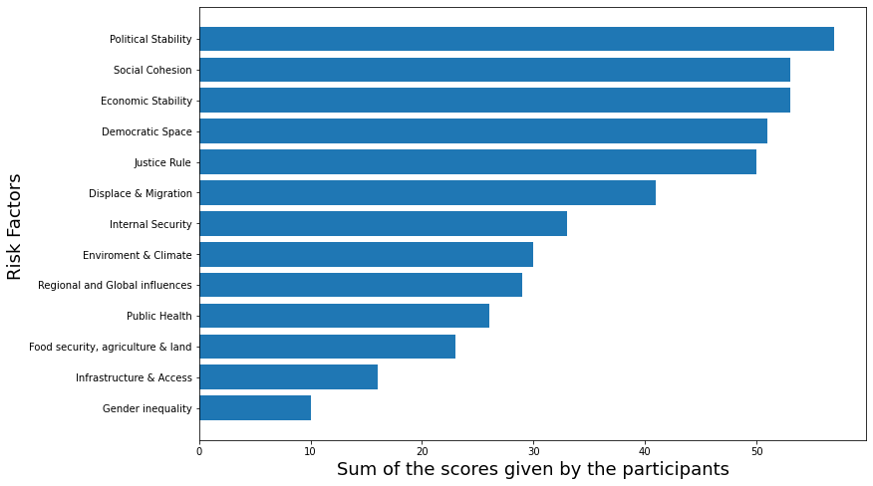
Risk predictors: Globally aggregated based on the scores
Top 5 Risk predictors

Slide 18
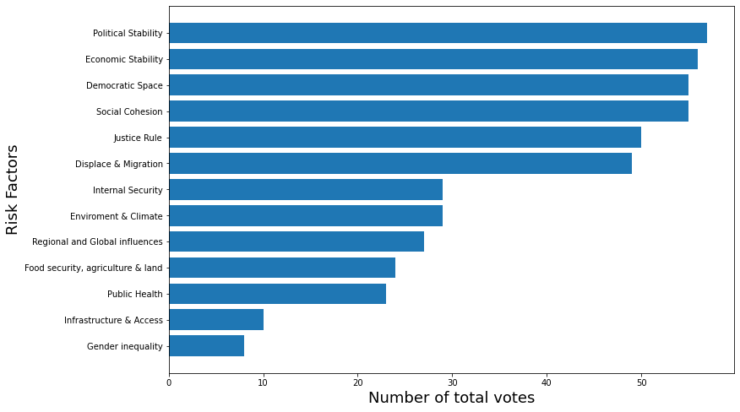
Risk predictors: Globally aggregated based on the number of votes
Top 5 Risk predictors

Slide 19
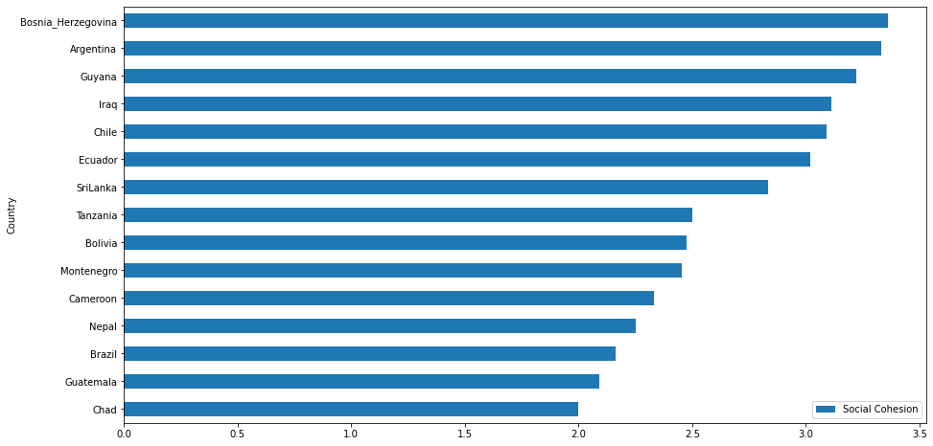
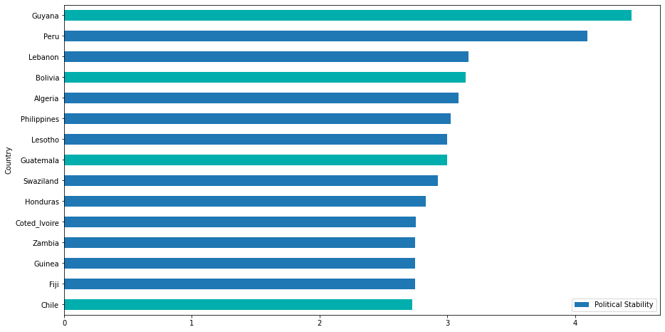
Overlap: Countries and Risk Predictors
Social Cohesion
Overlapping Countries
Political Stability
Score given by Participants
Score given by Participants

Slide 20
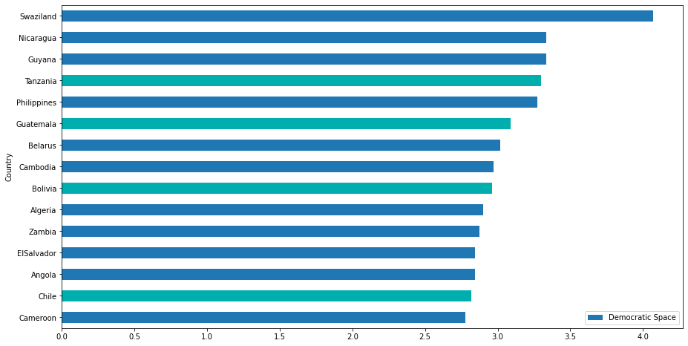
Overlap: Countries and Risk Predictors
Social Cohesion
Overlapping Countries
Democratic Space
Score given by Participants
Score given by Participants

Slide 21
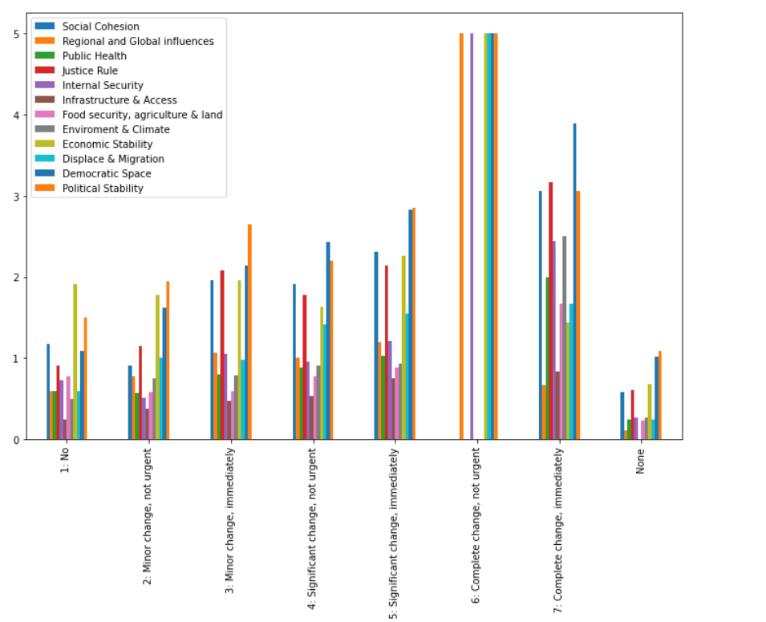
UN urgency on a global scale
A minority of participants think that UN action does not need to change across any risk factor
Most participants believe that on a global scale, sweeping changes are required but not urgent in areas such as Internal Security, Political Stability
Most participants believe that on a global scale, urgent and sweeping changes are needing in areas Social Cohesion, Justice and Rule and Democratic Space.
Mean global importance of risk factors
Participant UN Engagement Responses

Slide 22
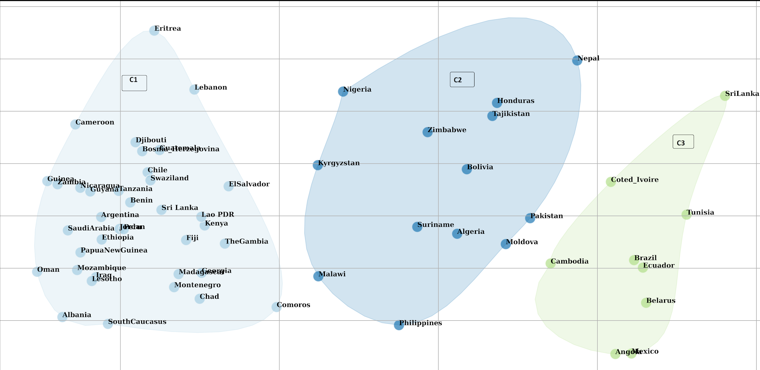
Urgency assessment clusters
Grouping countries based on participant perceptions of urgency in UN intervention.
Goal: Enabling UN to allocate resources to countries in effective timeframes.
Features: 7 qualitative features for UN action urgency.
Algorithm: K-Means
Cluster C1:
Countries in this cluster believe that UN intervention needs a complete change, and it needs to happen immediately.
Cluster C2:
Countries in this cluster believe UN needs to enact some minor changes immediately but significant changes are not urgent.
Cluster C3:
Countries in this cluster expressed that significant changes need to be enacted immediately.
C2
C3
C1
‹#›

Slide 23
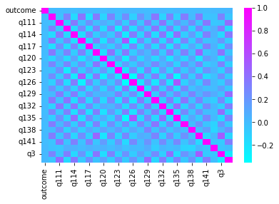
Can we predict a country’s current risk?
Goal: Predict priority risks using answers to other questions. X – Questions’ Answers, Y – Risk Factors
Metric: Overlap Score
Since the outcome is a multi-select variable, we need to look at both Precision and Recall.
Model Performance:
Random Forest: 41%
Naïve-Bayes: 43%
Severe Class Imbalance:
Infrastructure & access to social services – only 45 instances
Internal Security – only 114 instances
Insignificant Correlation with Outcome

Slide 24
Where we are so far…
Milestones | Date
Created and presented project charter to sponsor | 10/04/2022
Presented initial insights and findings to sponsor | 10/19/2022
Presented results and correlated factors to priority risk areas to sponsor | 10/31/2022
Perform model building on new data | 11/15/2022
Presented results and correlated factors to UN Action Urgency to Sponsor | 11/20/2022
Complete script, report and hand over to sponsor | 11/30/2022
Complete Final Presentation | 12/14/2022

Slide 25
Thank You

